Slide 1
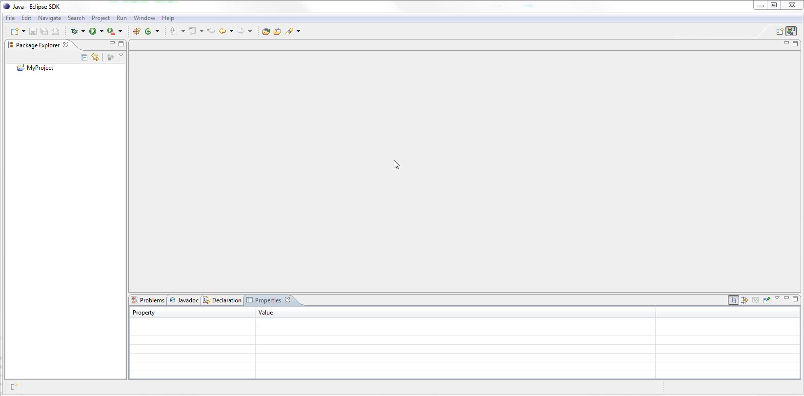
Notes:
Basic Eclipse setup
Toolbars
Package Explorer
Editor
View
Very customisable

Slide 2
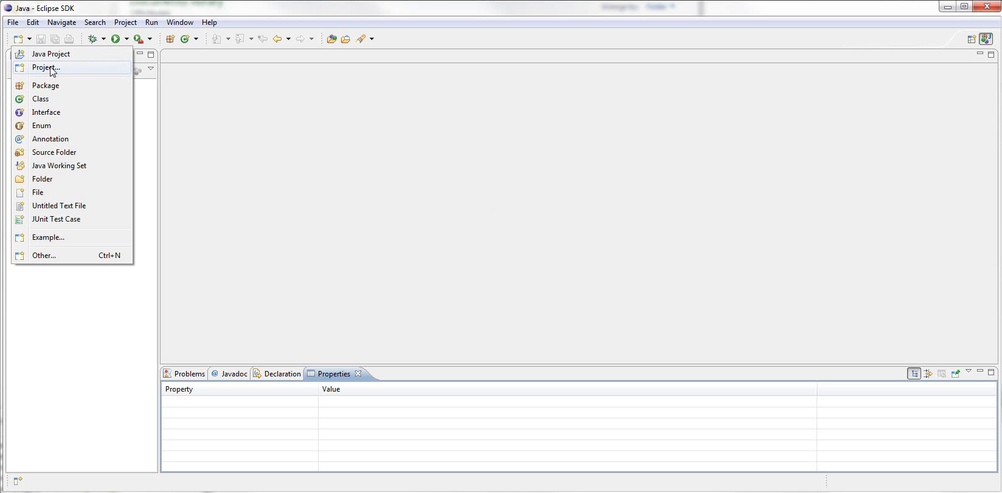
Notes:
Start with creating new project
Zoom

Slide 3
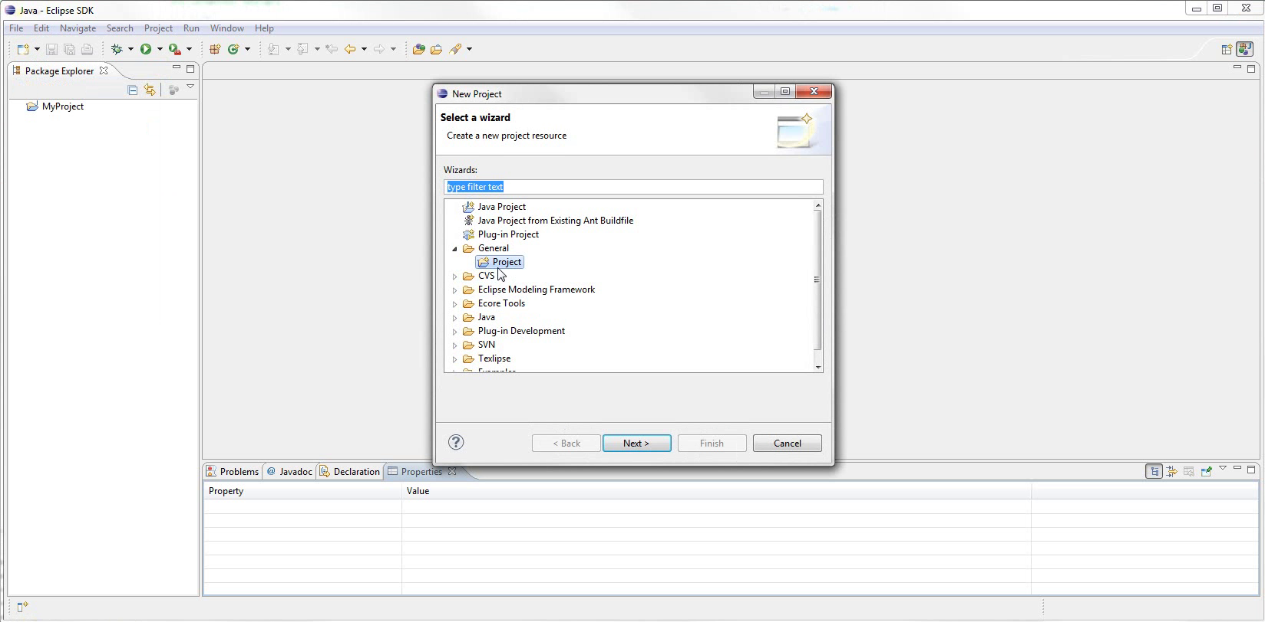
Notes:
Wizard
zoom
lets you choose several types of project
We just need general project

Slide 4
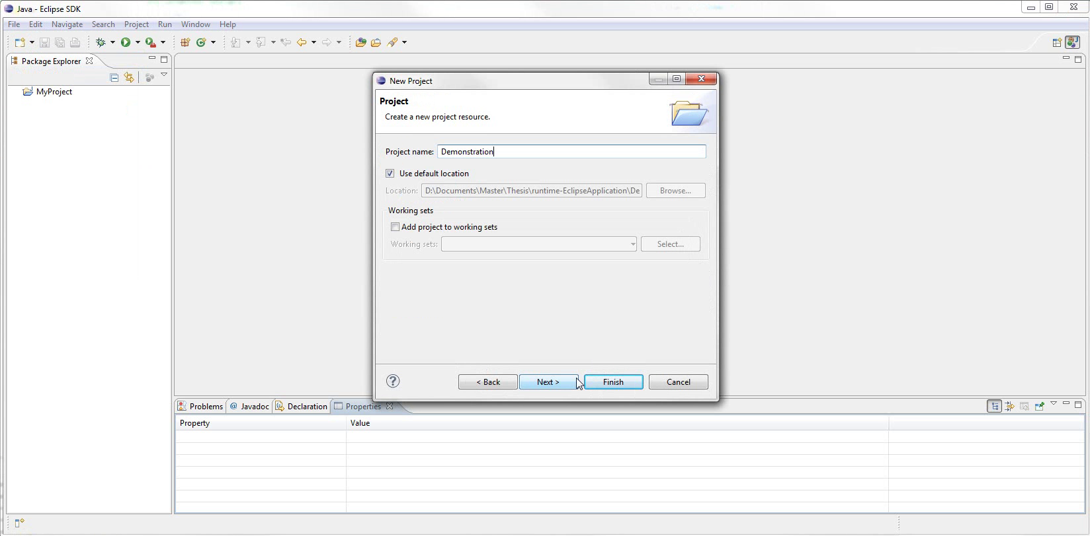
Notes:
We give the project a name
Can choose location and other settings
Hit Finish

Slide 5
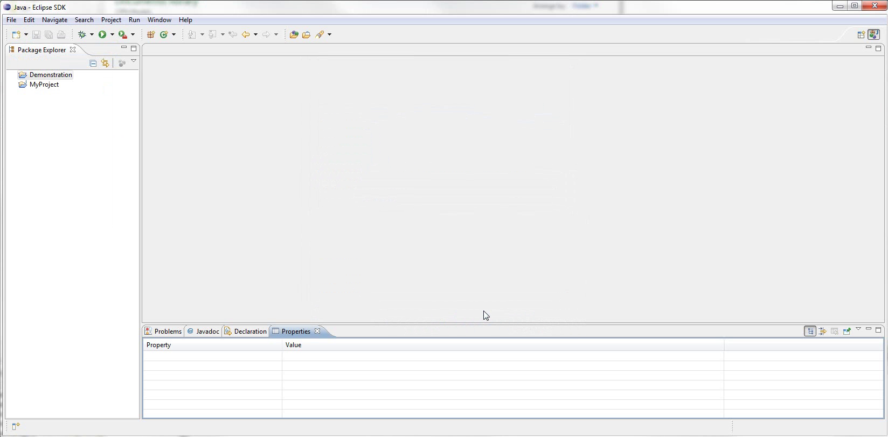
Notes:
Can see the project in explorer
We now want to import the Websocket CPN model
More than one way to run importer

Slide 6
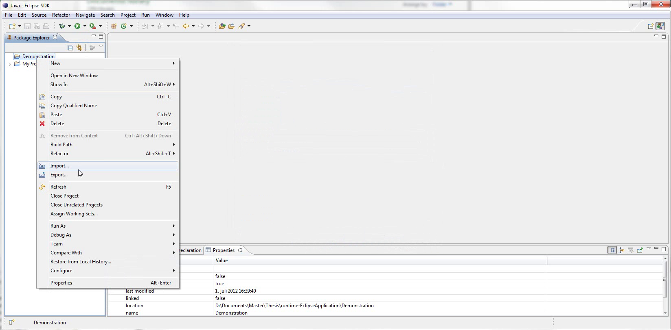
Notes:
Right click project and select import

Slide 7
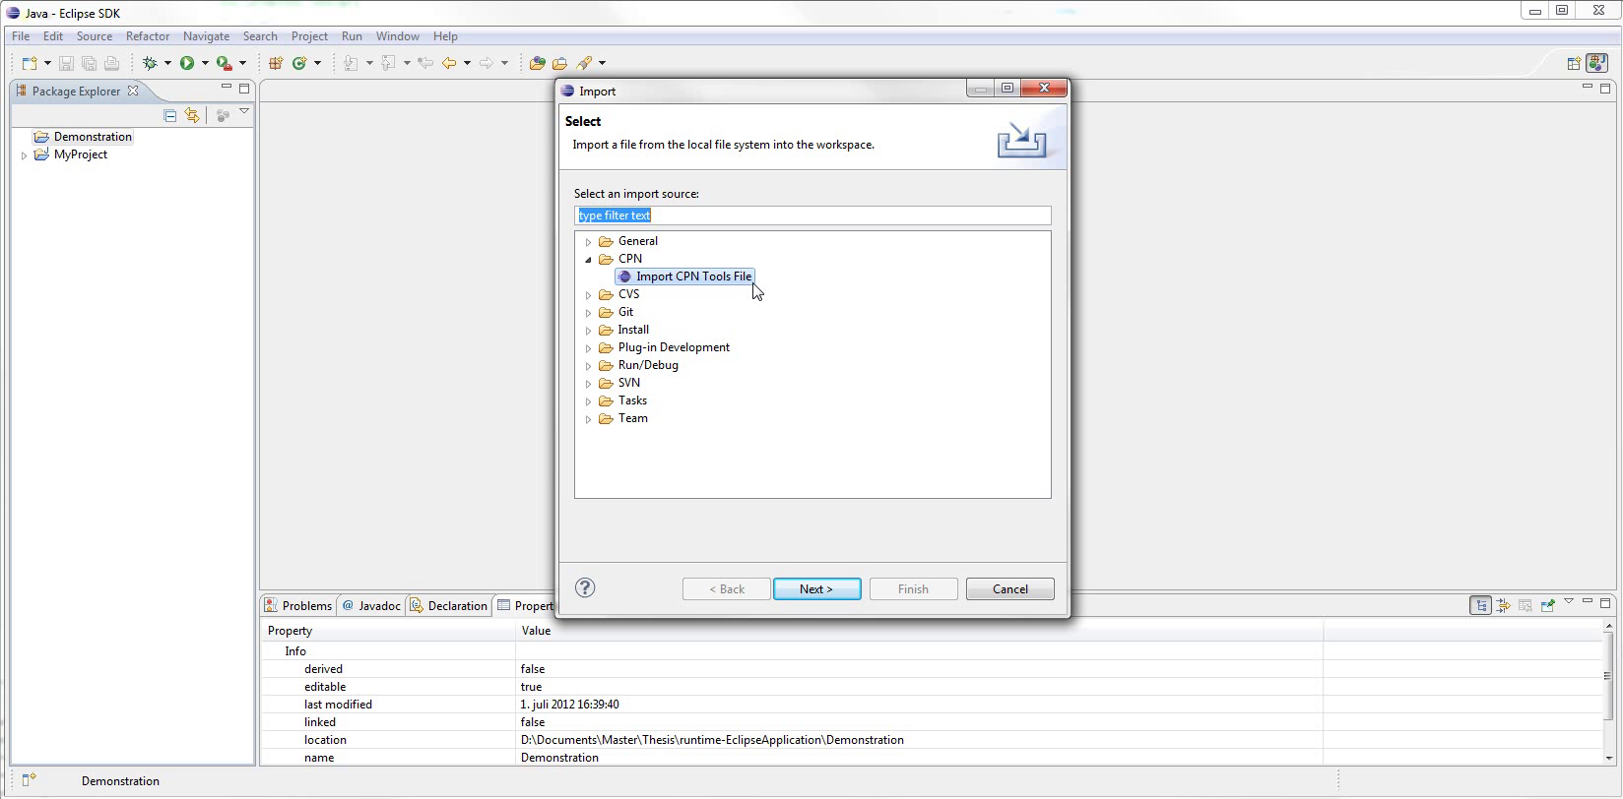
Notes:
This is Import dialog
Zoom
Can select from many available importers

Slide 8
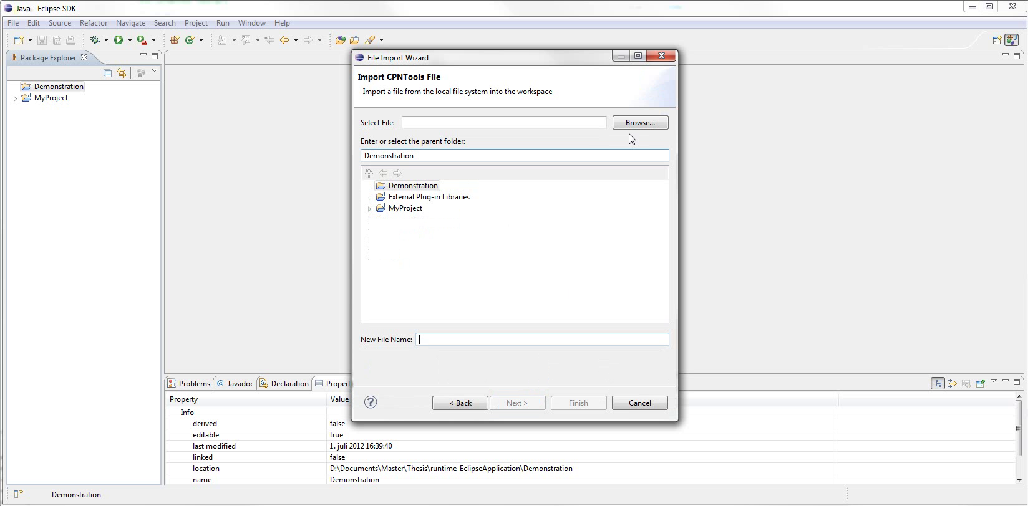
Notes:
This is the CPN importer
Need two things:
Select the cpn file to import
Select where to put the imported model
So we hit Browse...

Slide 9
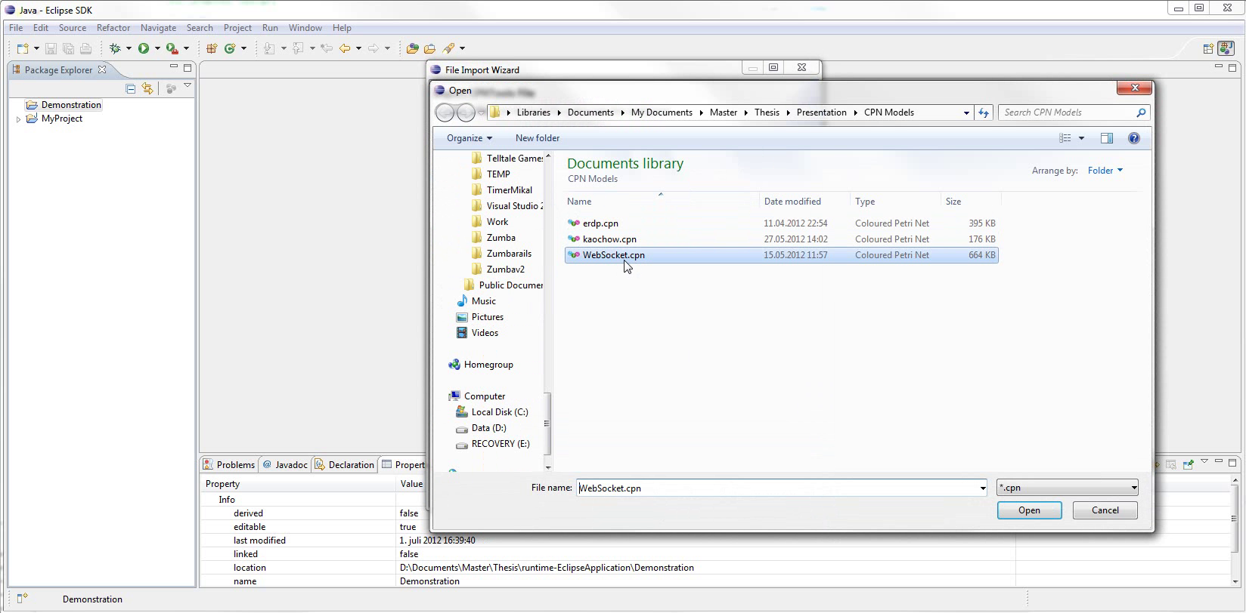
Notes:
Select the cpn file

Slide 10
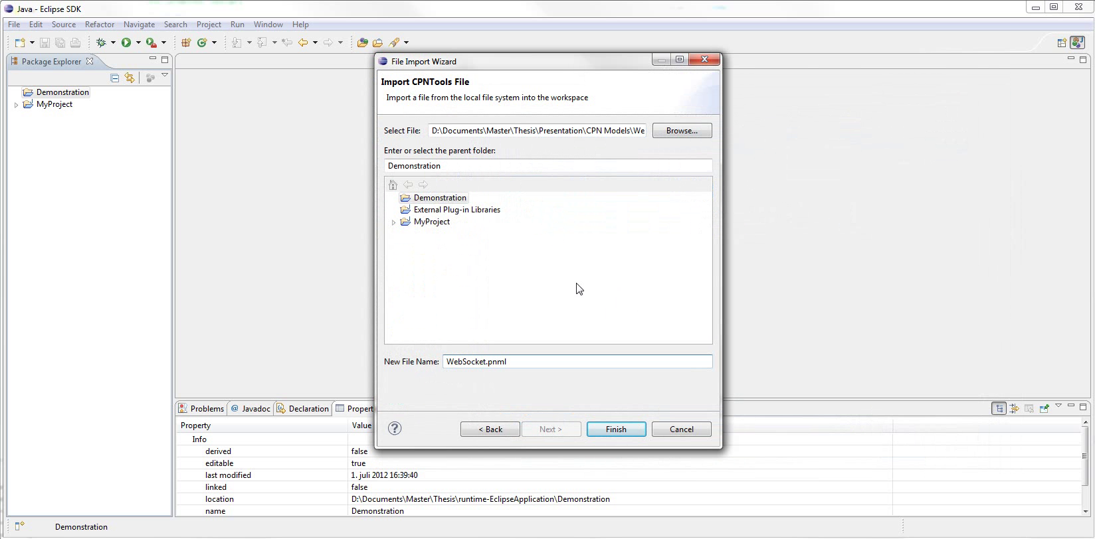
Notes:
Demonstration project already selected
File name suggested (new extension)

Slide 11
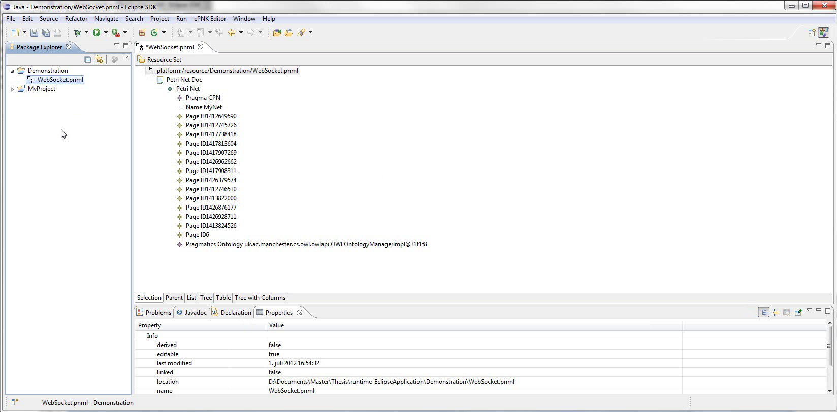
Notes:
Here is result
Note file contained in project
Model elements labeled by ID
Also have a Pragmatics Ontology instance

Slide 12
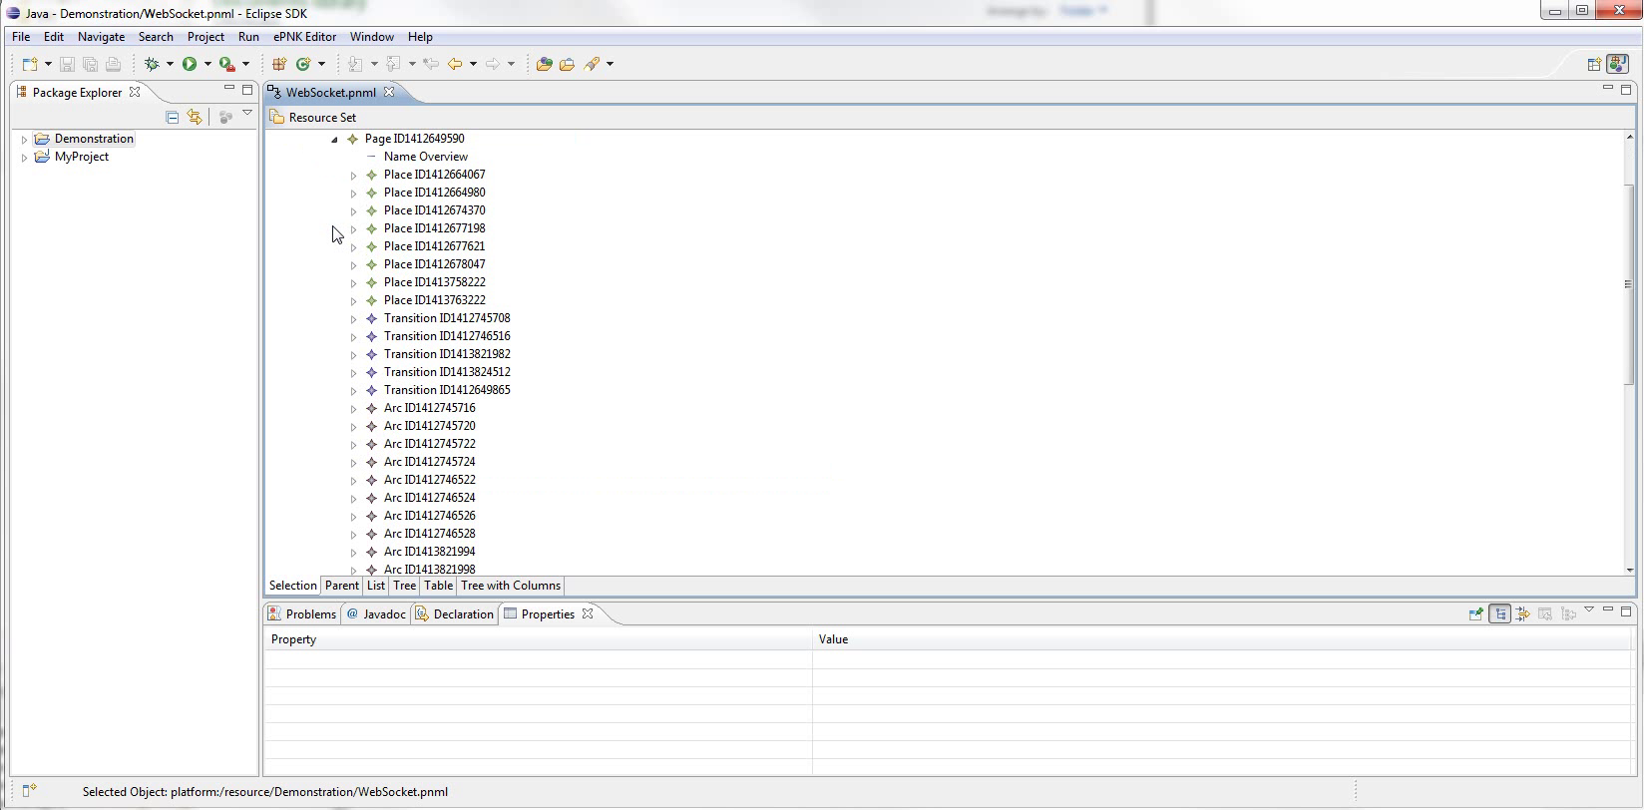
Notes:
Here is the child elements of the Overview page

Slide 13
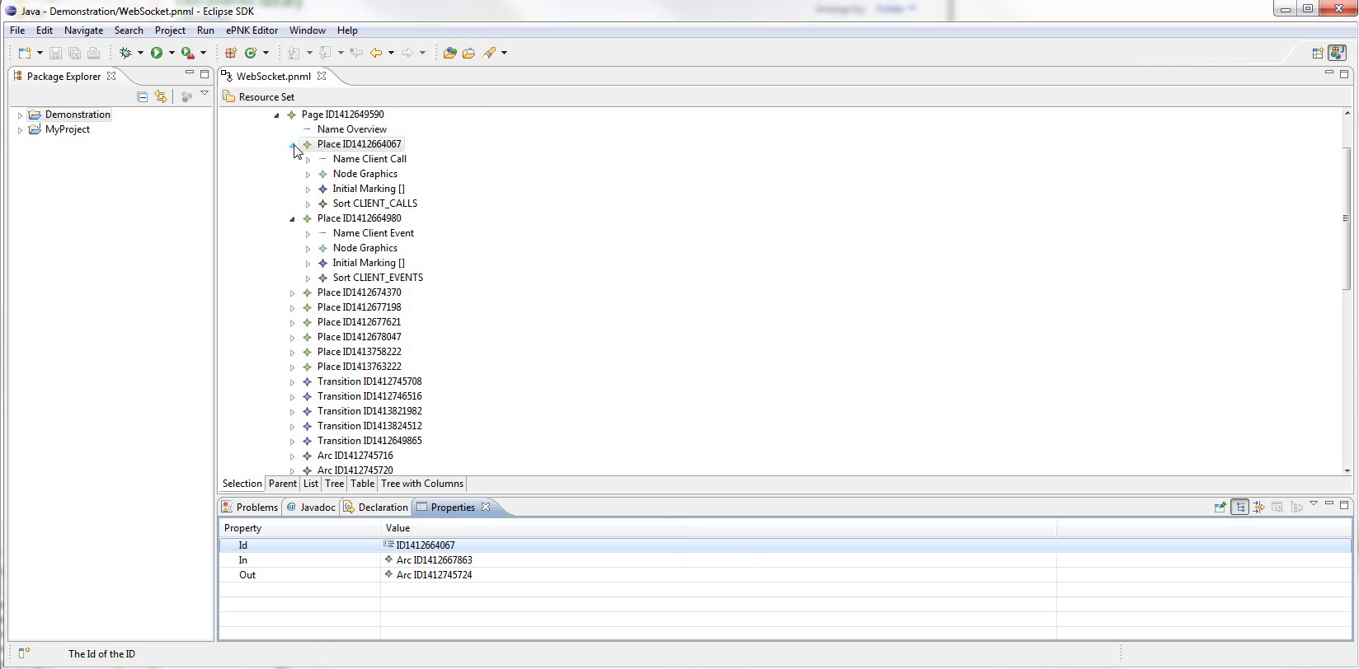
Notes:
A few places expanded to show their child elements
Reasons for this
Note properties view at bottom

Slide 14
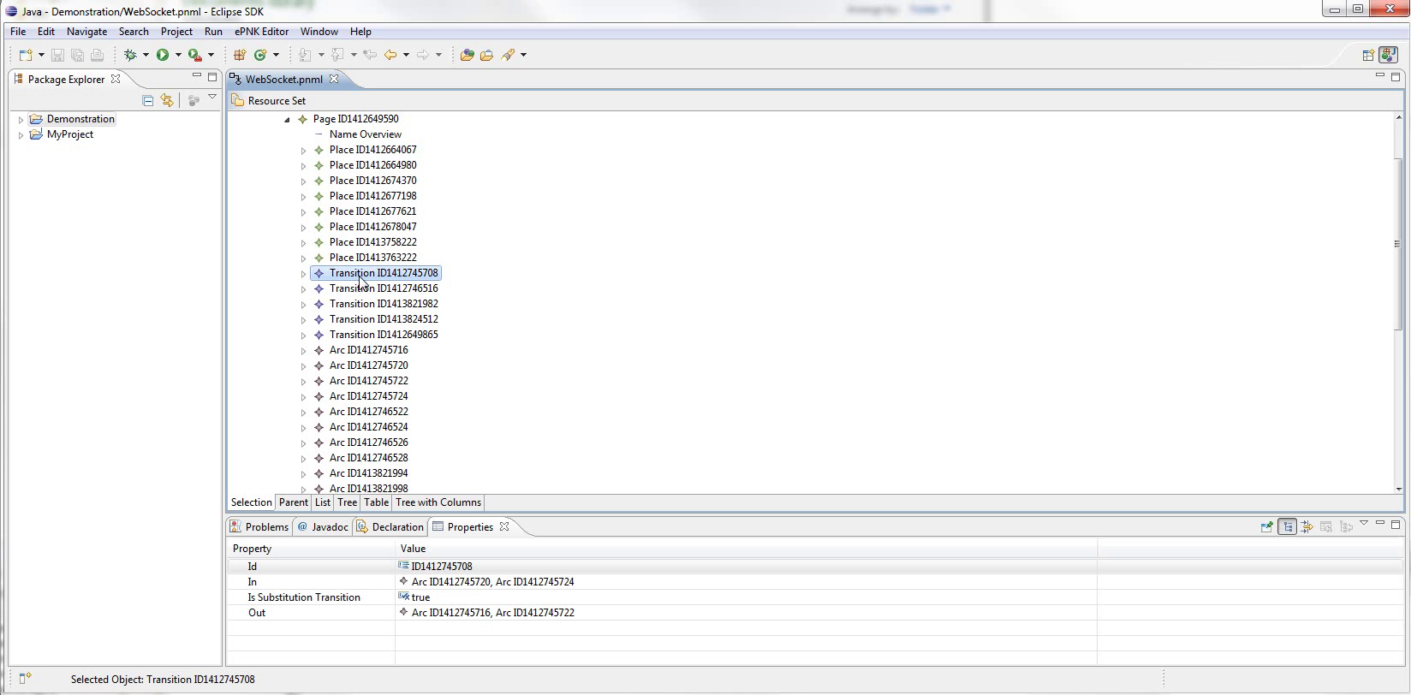
Notes:
Different for each element
Zoom for details

Slide 15
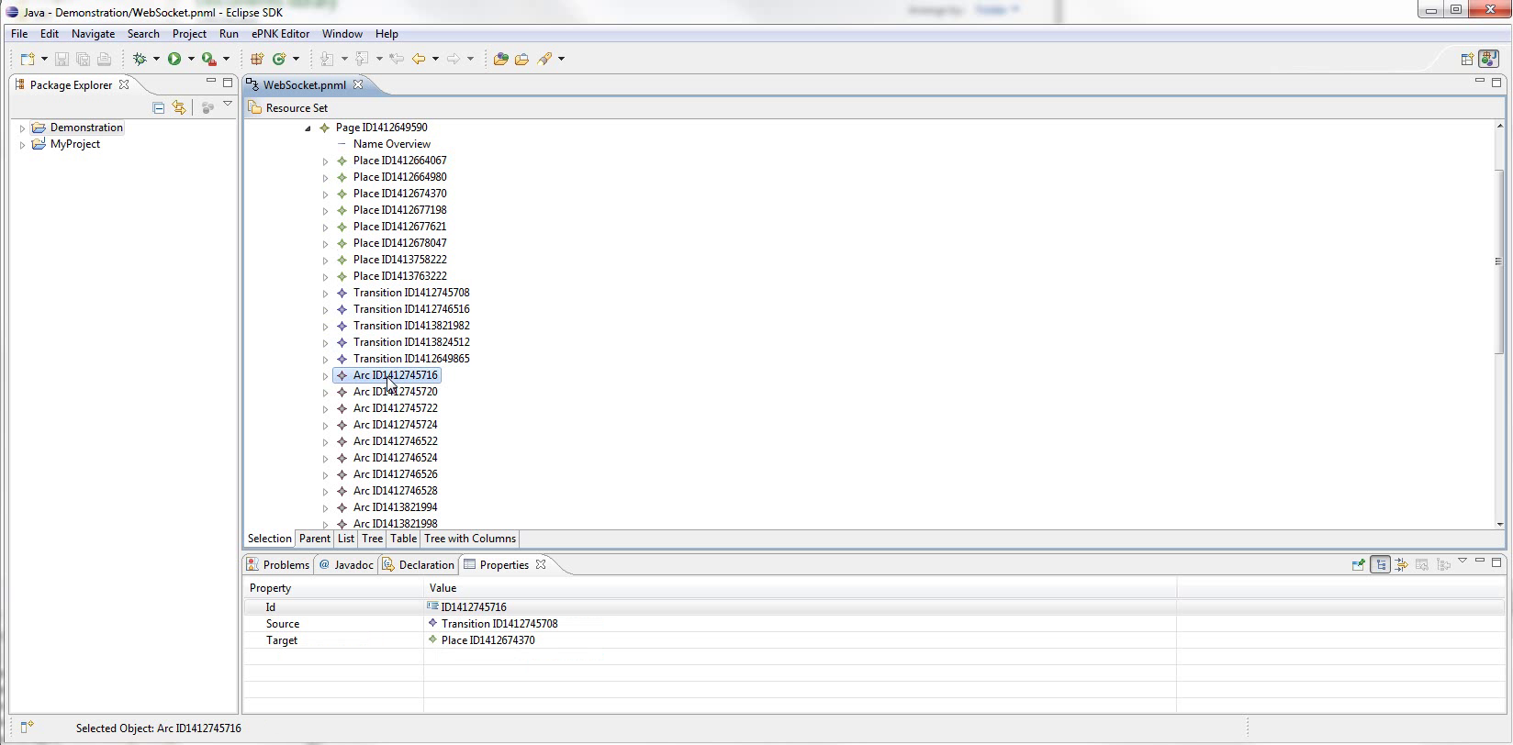
Notes:
A bit difficult to visualise
So by double clicking a page, we can open the diagram editor

Slide 16
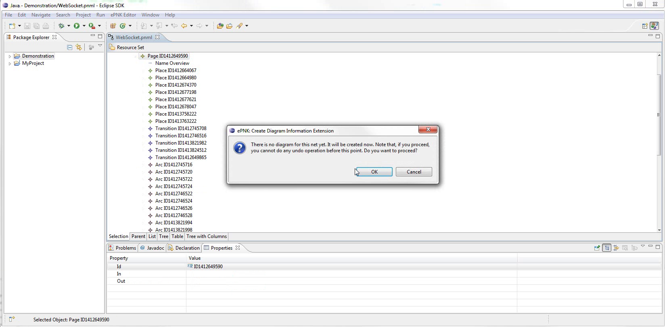
Notes:
zoom
It will ask to generate some extra data for the model

Slide 17
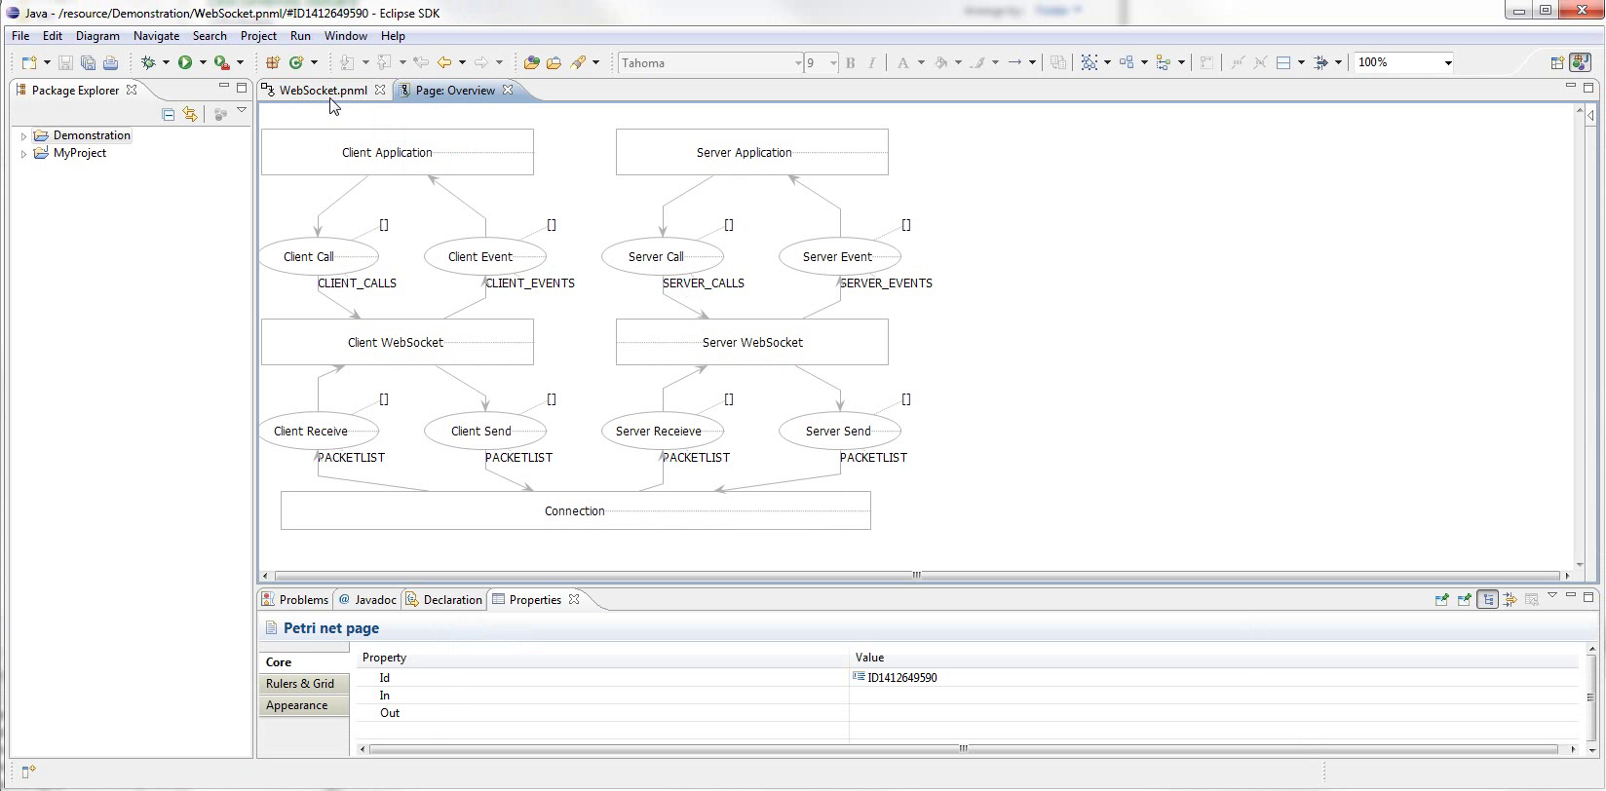
Notes:
Here it is.
Layout isn’t perfectly mirrored from CPN Tools, but everything can be manually adjusted.
Eclipse is very customisable, so we can...

Slide 18
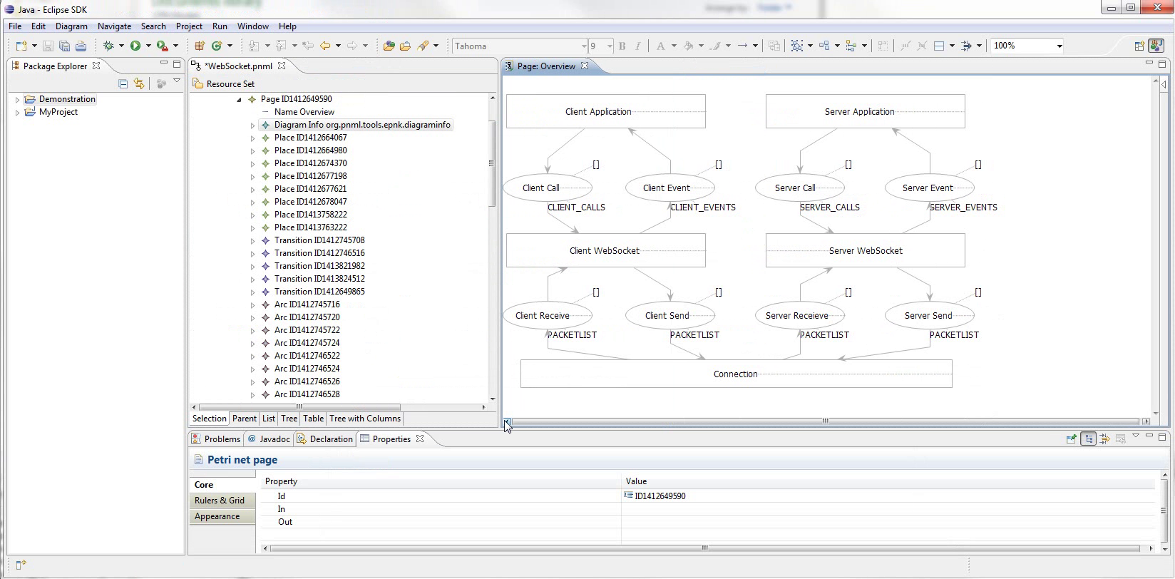
Notes:
... Show both editors at once.
Unfortunately not synchronised

Slide 19
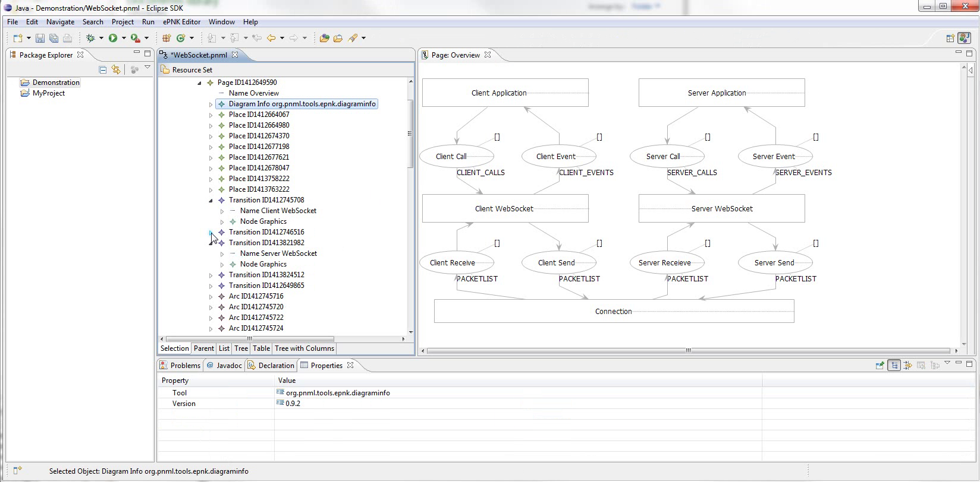
Notes:
Using editors together, we locate the model elements we want to annotate
First, annotate Principals

Slide 20
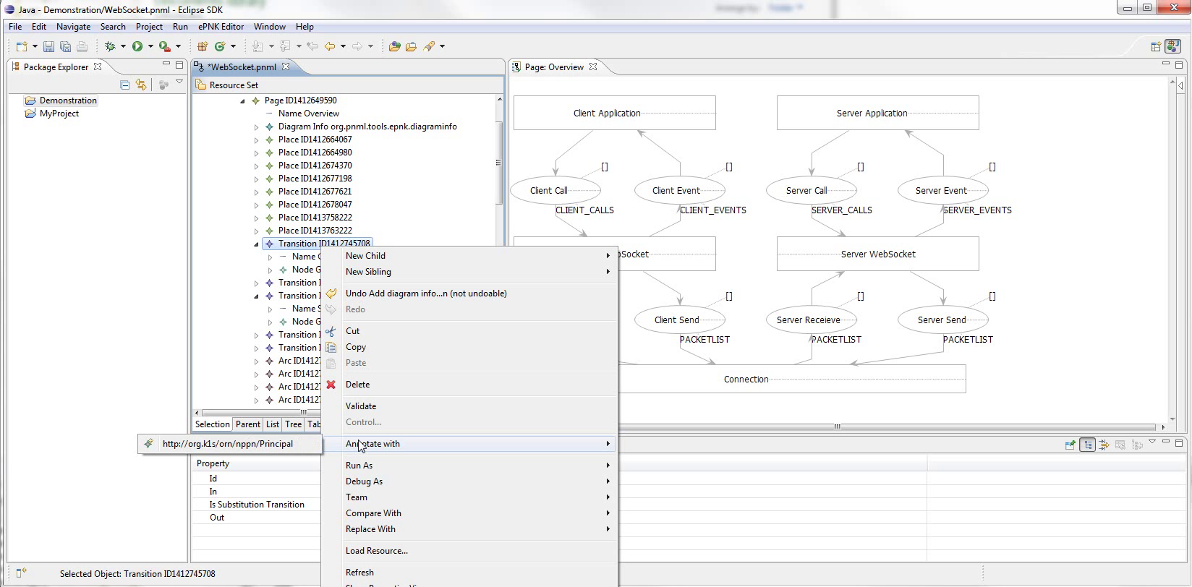
Notes:
Right click the element, show Annotate With submenu,
Zoom
shows only applicable pragmatics.

Slide 21
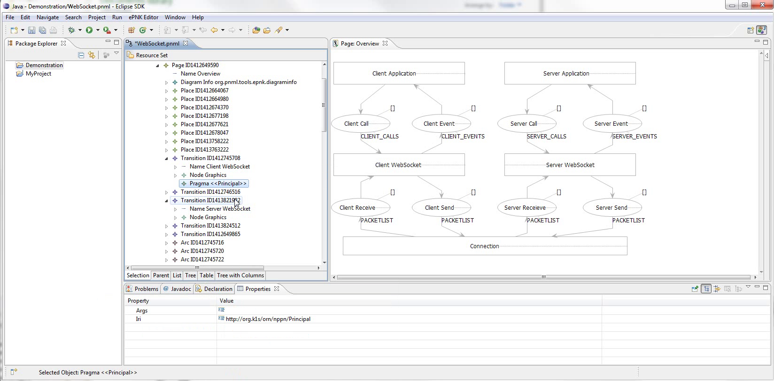
Notes:
Here the element is annotated.

Slide 22
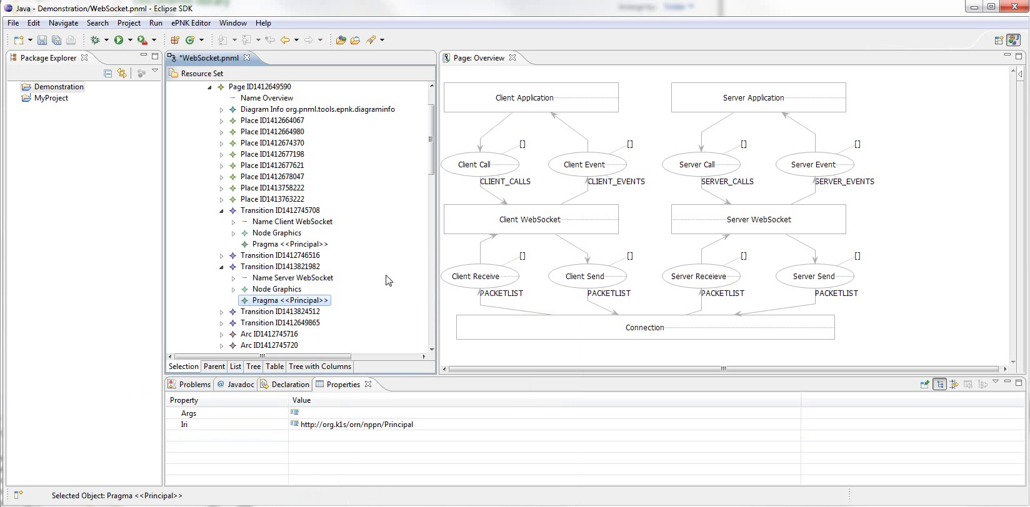
Notes:
And the other one as well.
Next, annotate channels

Slide 23
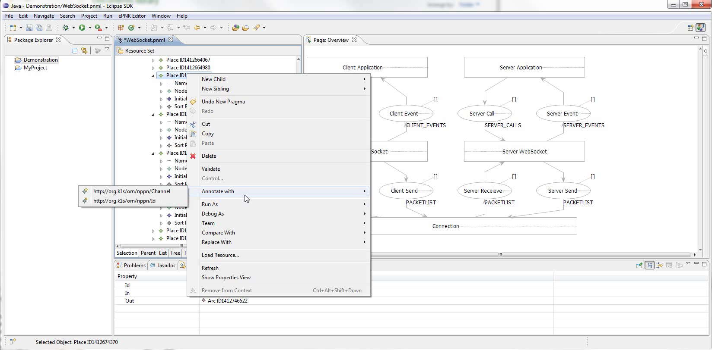
Notes:
Here we see the menu for a Place
zoom

Slide 24
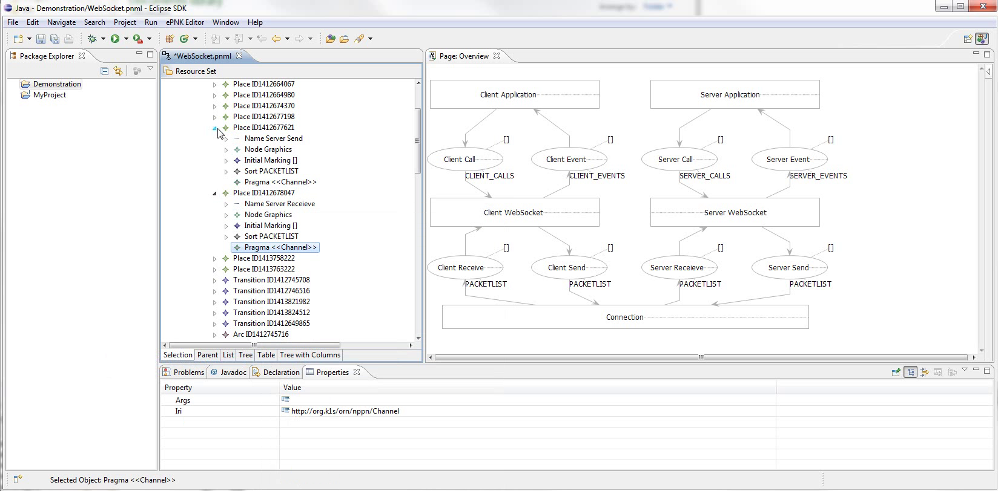
Notes:
Skip a little, And here the elements have all been annotated.

Slide 25
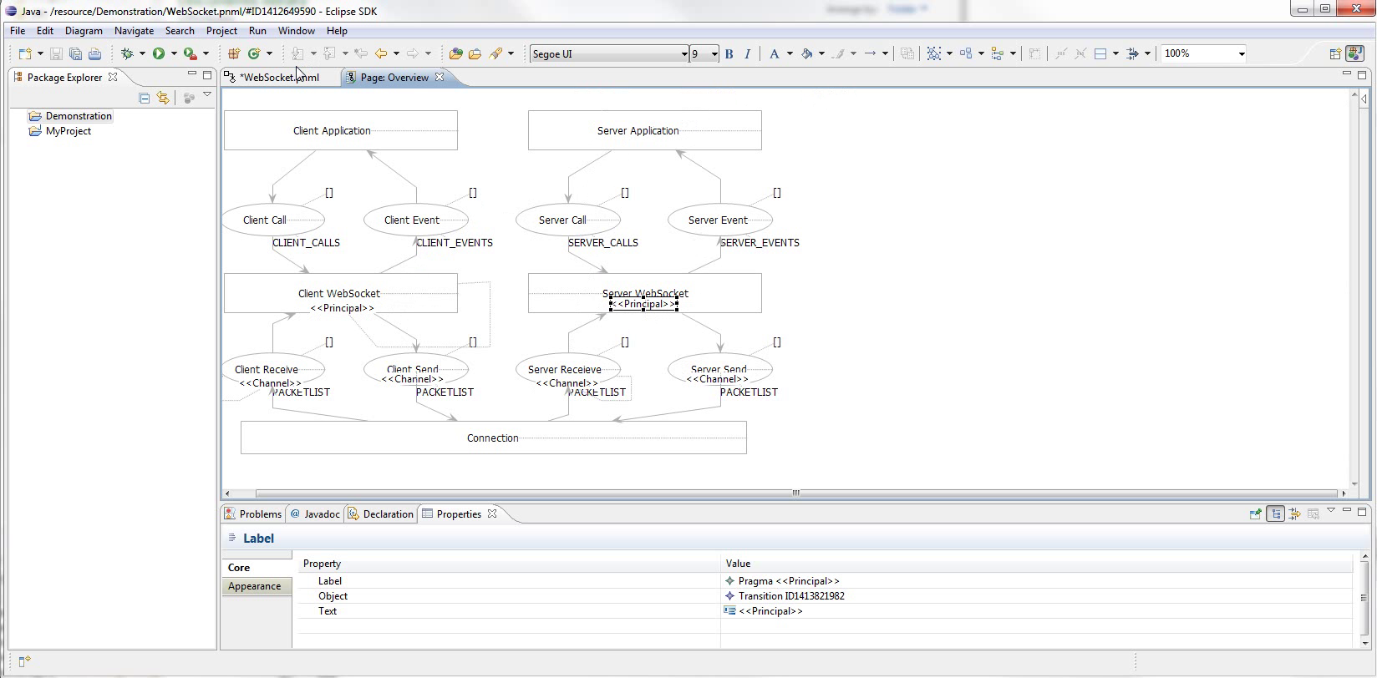
Notes:
To show this in the diagram editor, we need to close and reopen it.
New pragmatics will not automatically be properly positioned, but can be manually moved.
Zoom

Slide 26
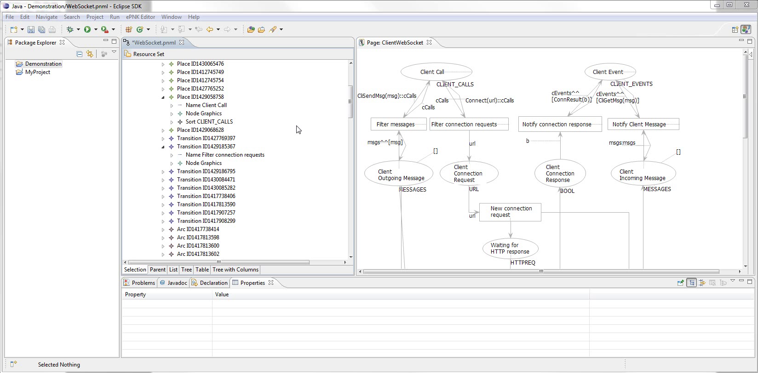
Notes:
Next up is the ID and External Pragmatics
Remember idea for them
So for example, one if the client calls is a connection request.
Zoom
Starts at transition Filter Connection Requests
But it needs to be connected by an incoming arc to a place annotated with Id

Slide 27
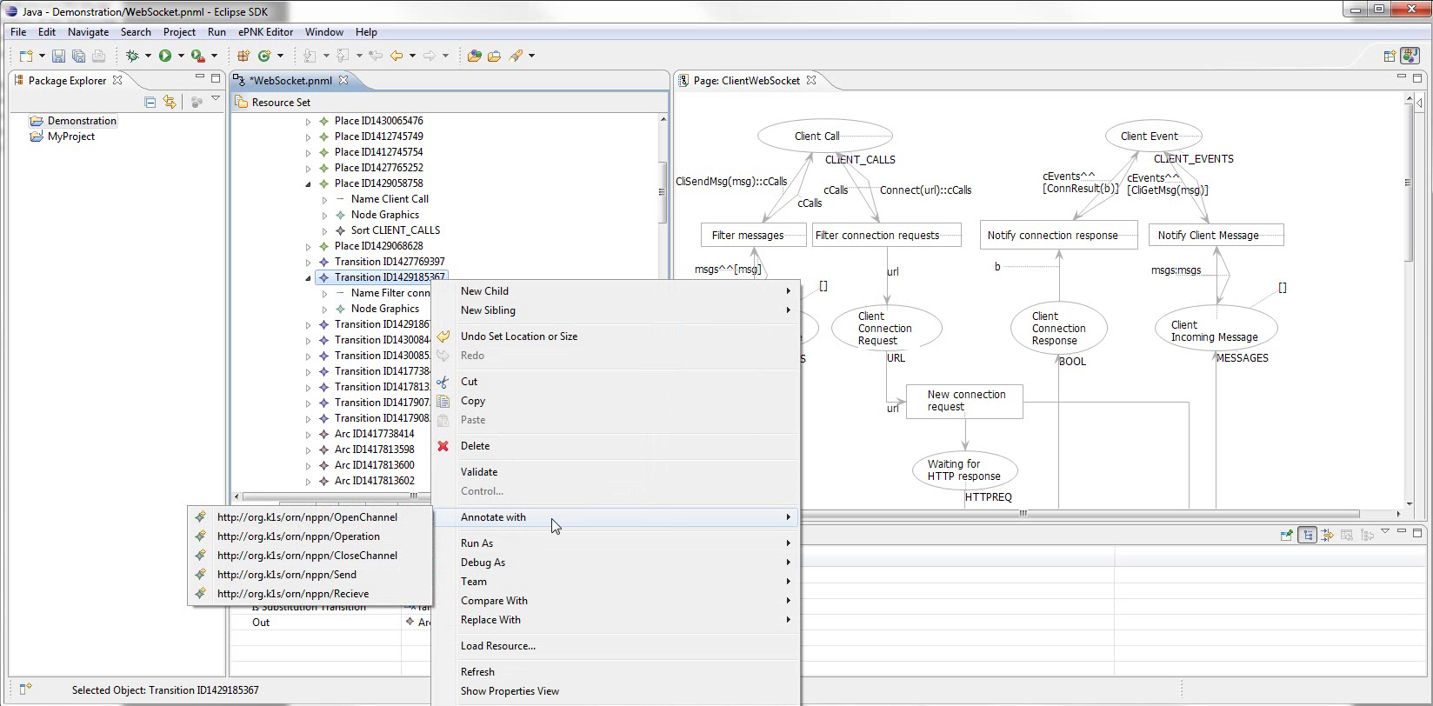
Notes:
If we try to annotate it,
Zoom
External isn’t available.

Slide 28
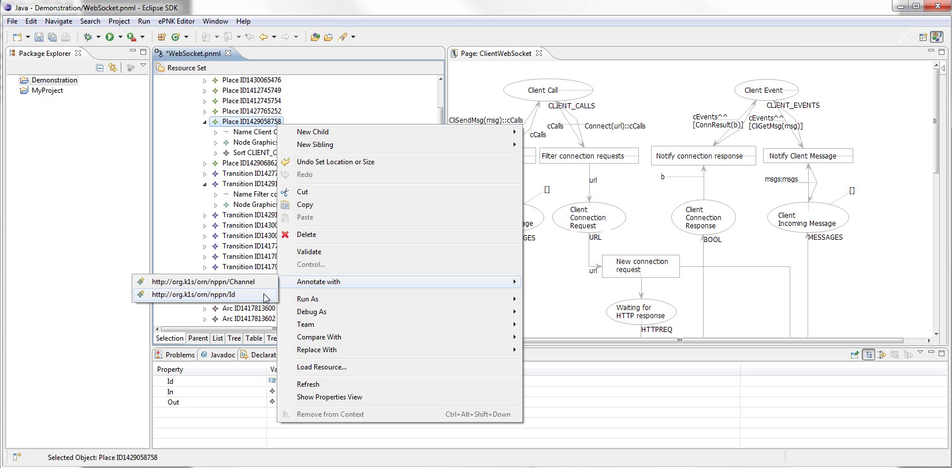
Notes:
However, if we first annotate Client Call with Id...

Slide 29
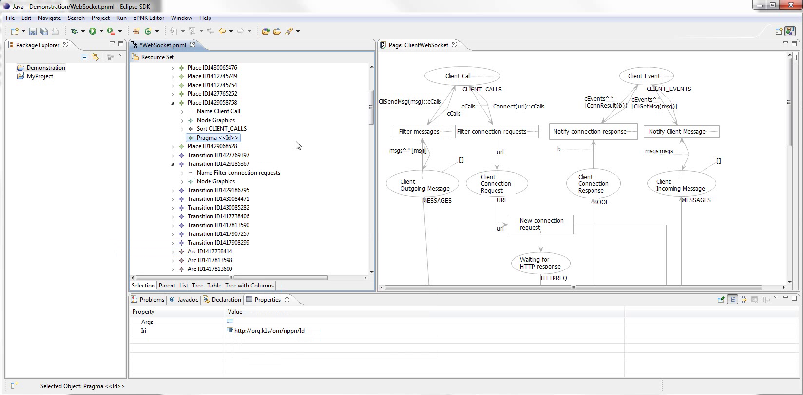
Notes:
Like so...

Slide 30
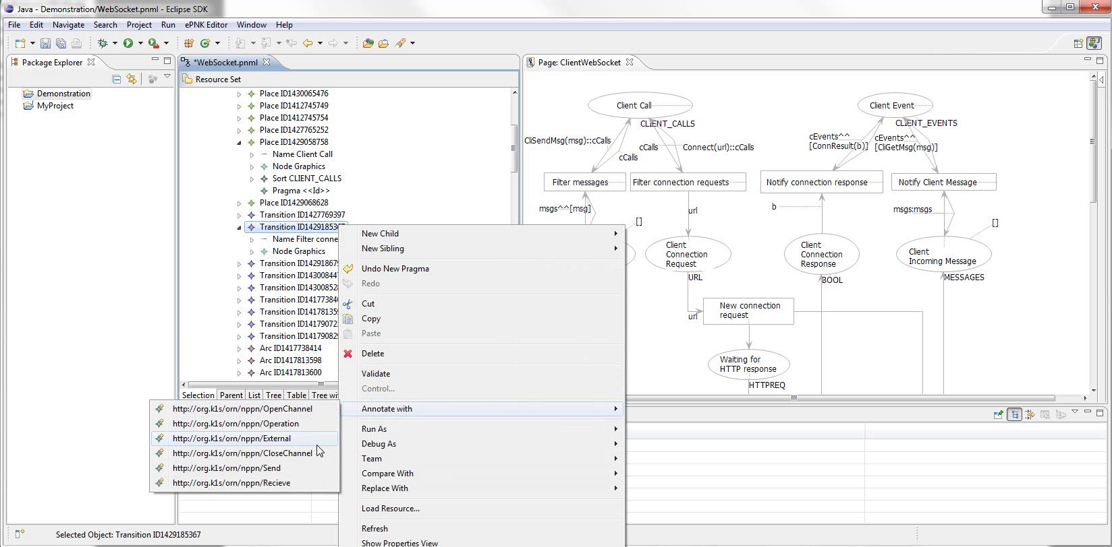
Notes:
Zoom
We now have External as an option for the transition

Slide 31
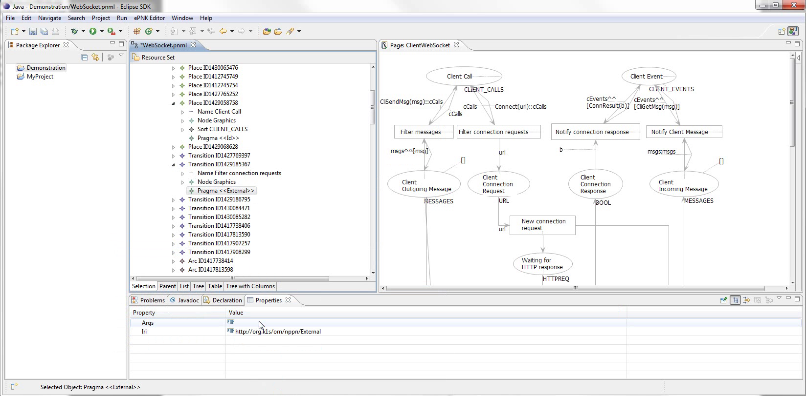
Notes:
Good time to demonstrate pragmatics arguments
zoom
Note that a pragmatic has a property args.
In the case of External, it signifies actual arguments for the external method.
If we click to edit it...

Slide 32
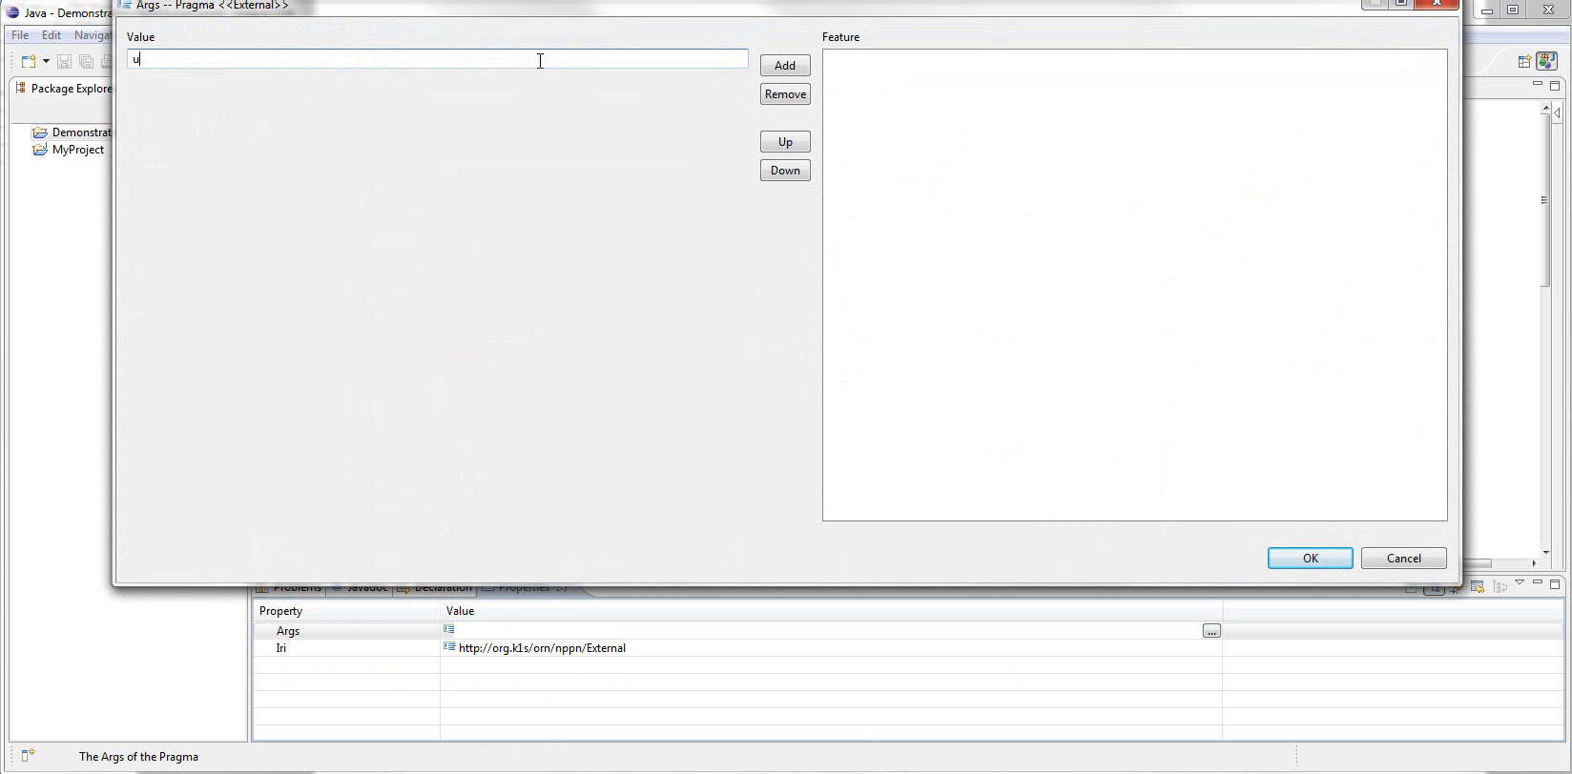
Notes:
We’re given a generic editor
Args is defined as a list of strings, so the editor lets us add and remove strings

Slide 33
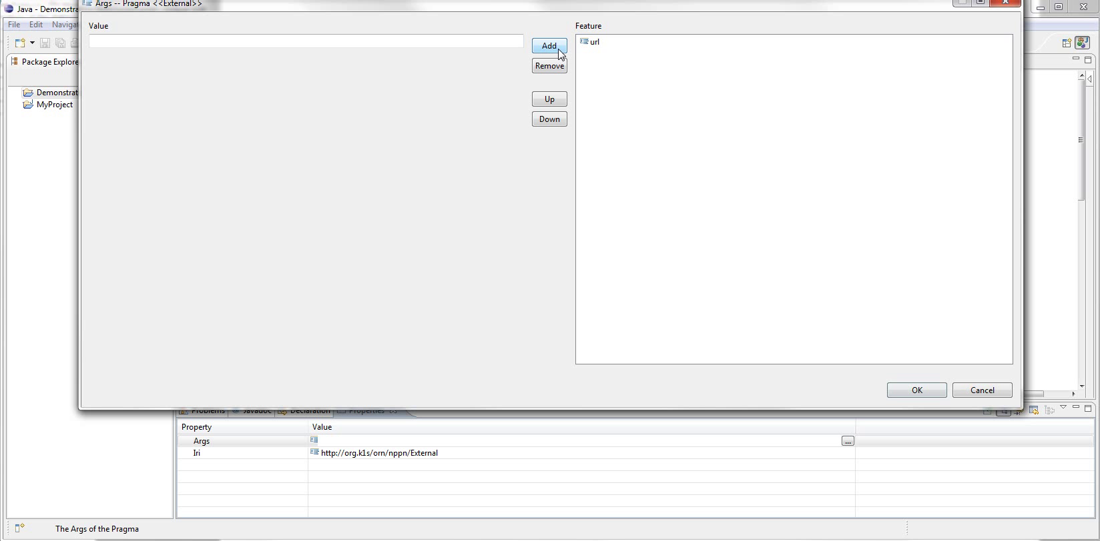
Notes:
We add the argument «url»

Slide 34
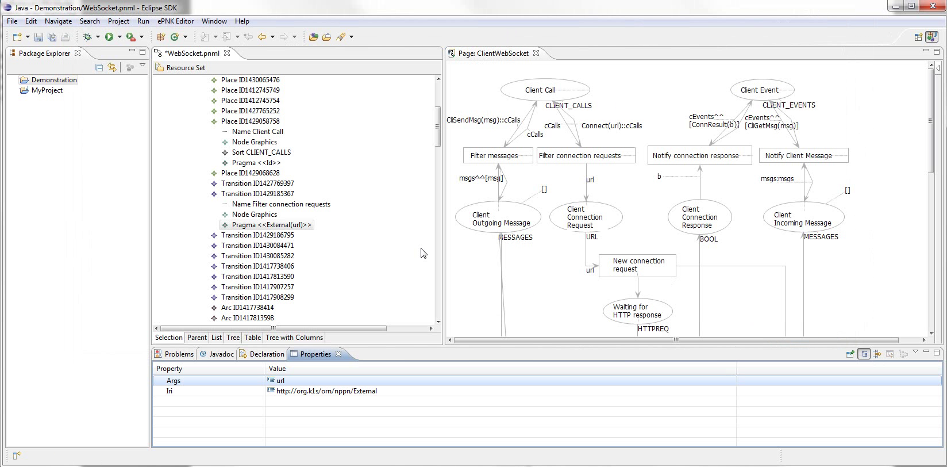
Notes:
And it’s now displayed in the pragmatic label

Slide 35
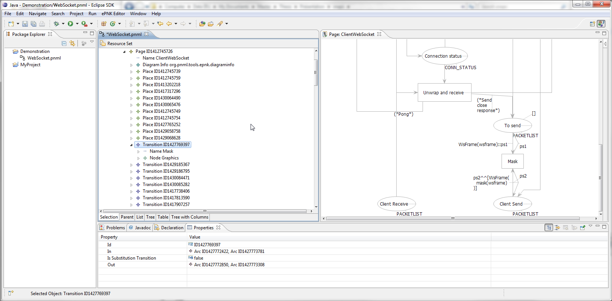
Notes:
Finally, show model specific pragmatics.
Suppose we want or need to handle masking specially
Showing the Mask transition
Let’s make a specific pragmatic for it

Slide 36
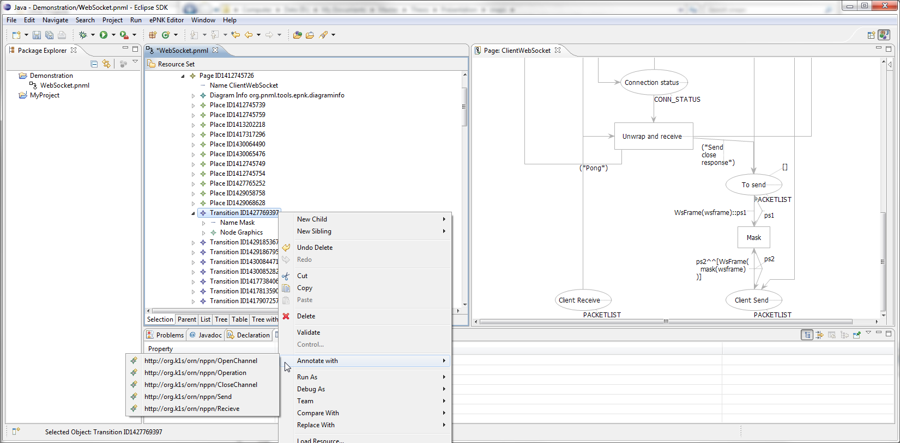
Notes:
Just to make sure, here’s the usual list for a transition

Slide 37
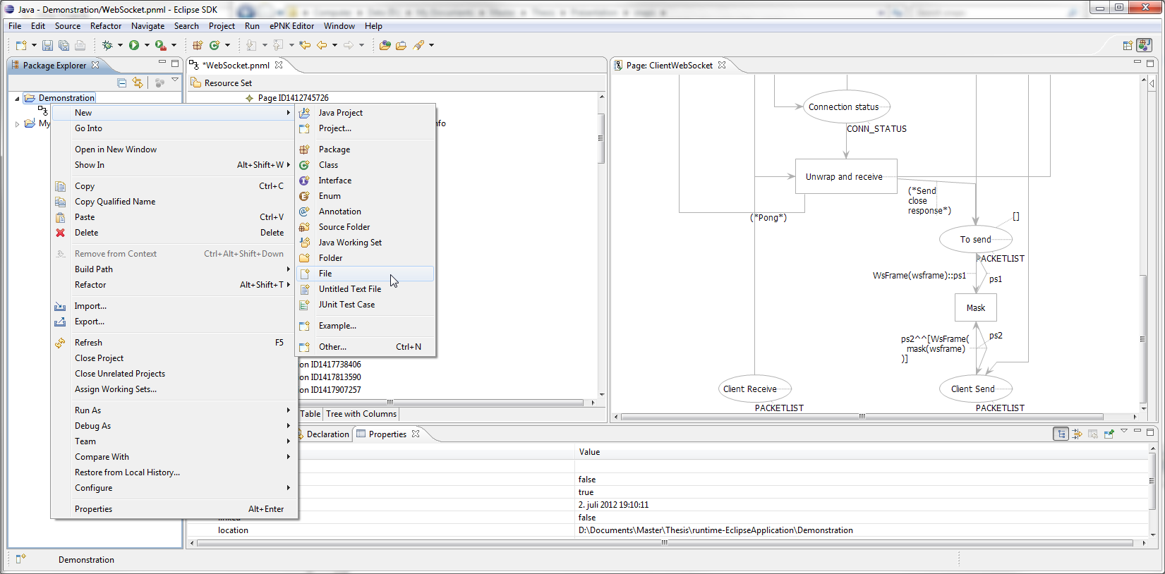
Notes:
We need to write an ontology for the pragmatic, so we create a new blank file.
Again, several ways
We right-click project, new, file

Slide 38
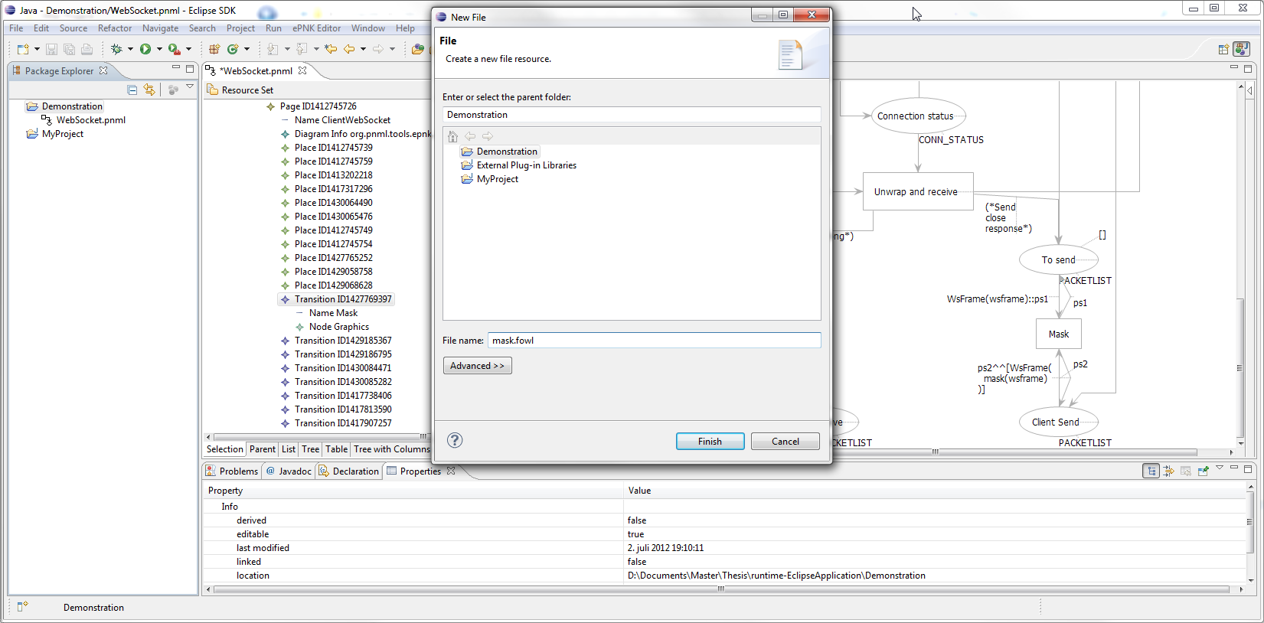
Notes:
Name it mask.fowl
Zoom

Slide 39
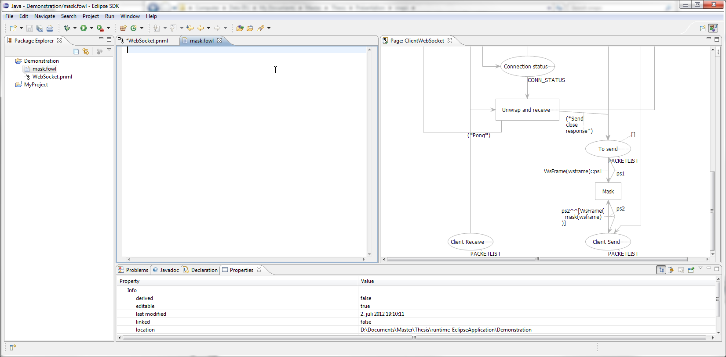
Notes:
The extension makes Eclipse automatically load an appropriate editor for the new file.
Simonsen has provided a basic editor with a few content assist features
If we activate it with ctrl space

Slide 40
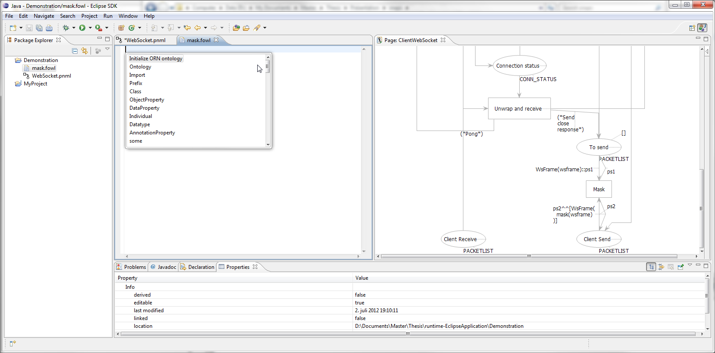
Notes:
We are given a list of suggestions that can be inserted
Zoom
The first one actually is a block of text containing default imports for pragmatics ontologies

Slide 41
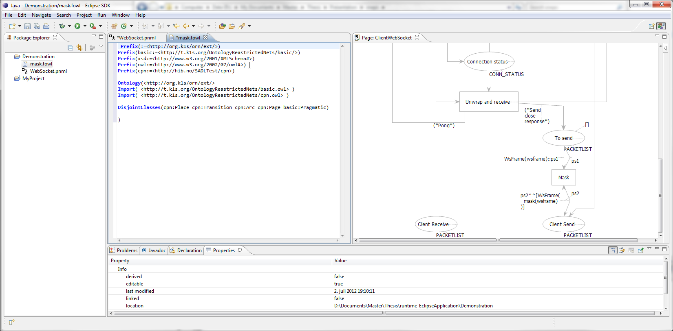
Notes:
Here is the result of selecting it

Slide 42
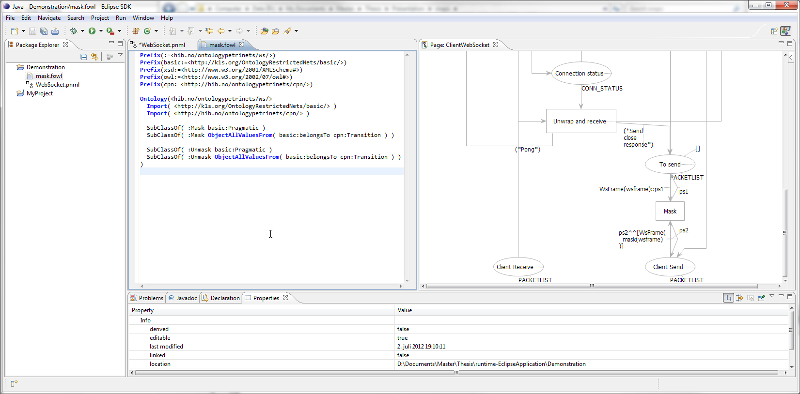
Notes:
We write our axioms, simply defining the classes Mask and Unmask, and restrict that both must belong to transition.
Save the file and close it.

Slide 43
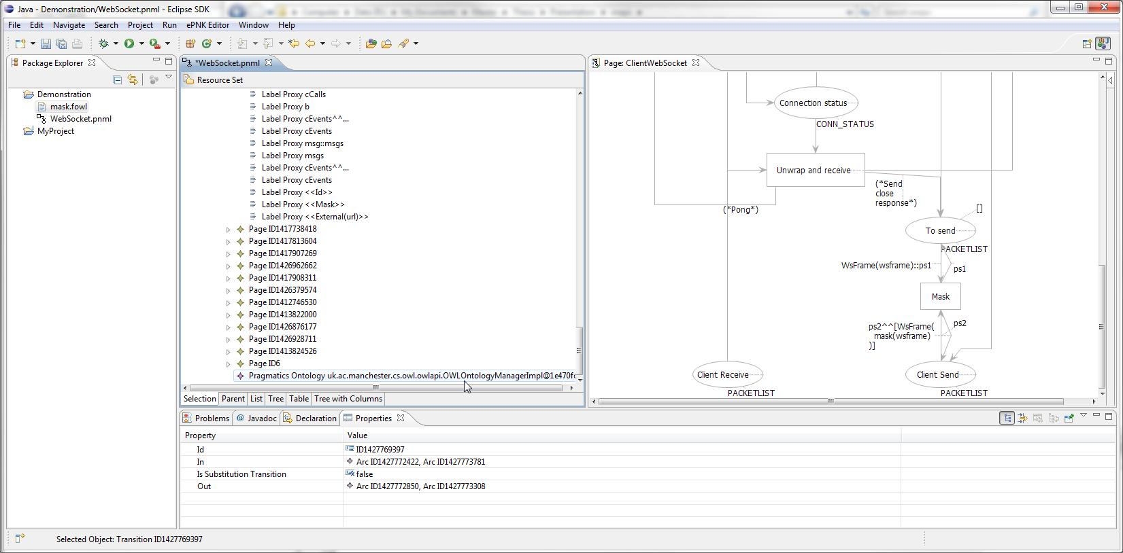
Notes:
Back in the model, find Pragmatics Ontology at the bottom
Right click it

Slide 44
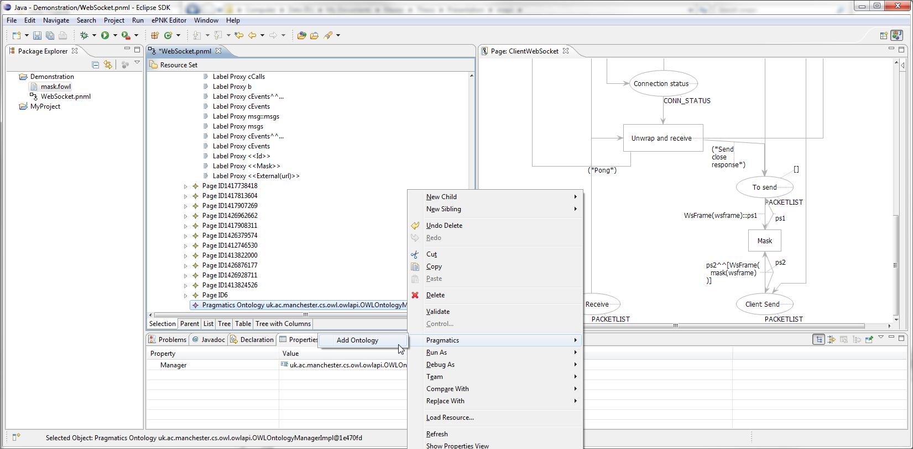
Notes:
Select pragmatics
Zoom
Add ontology

Slide 45
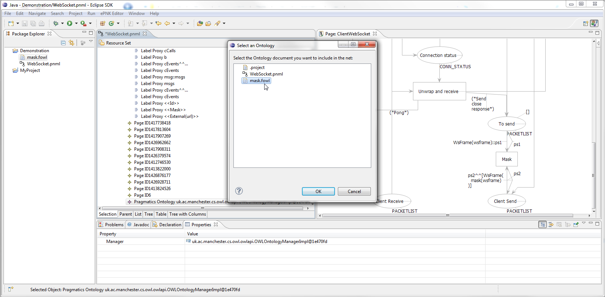
Notes:
File selector for all files in containing project
Not filtered for extensions currently, as not all ontology editors use correct extensions, and OWL API only looks at file contens
Same method used to add domain specific pragmatics
Could be extended to add ontology documents available online as well.

Slide 46
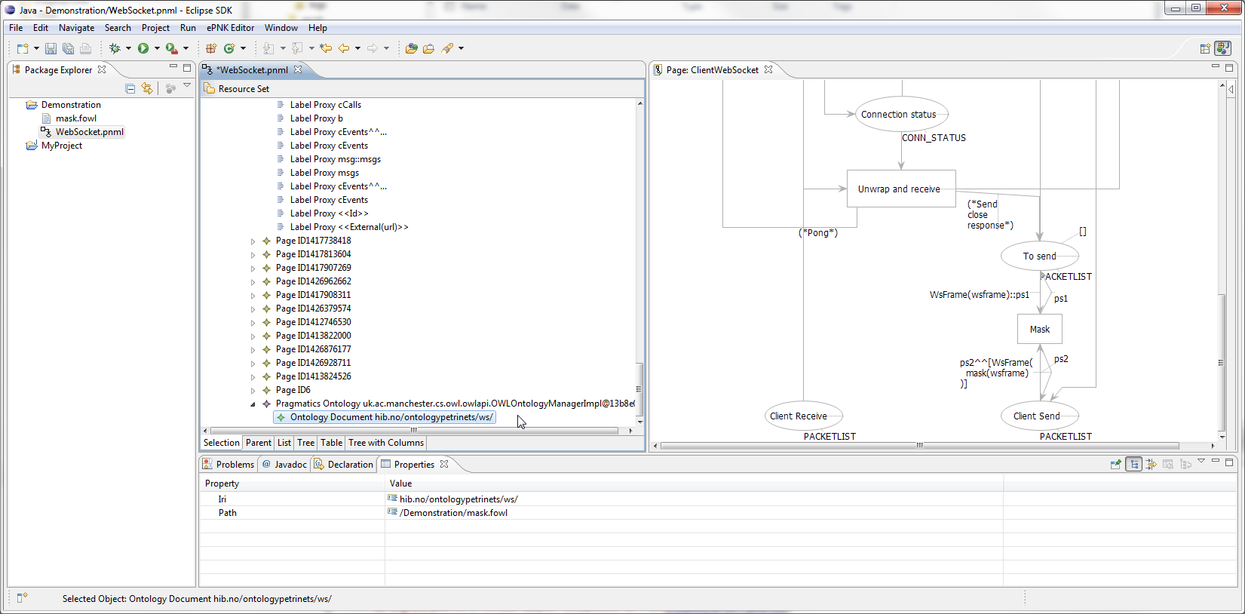
Notes:
Here we see (zoom) the ontology as a child element
Will be persisted and loaded (provided file still exists)

Slide 47
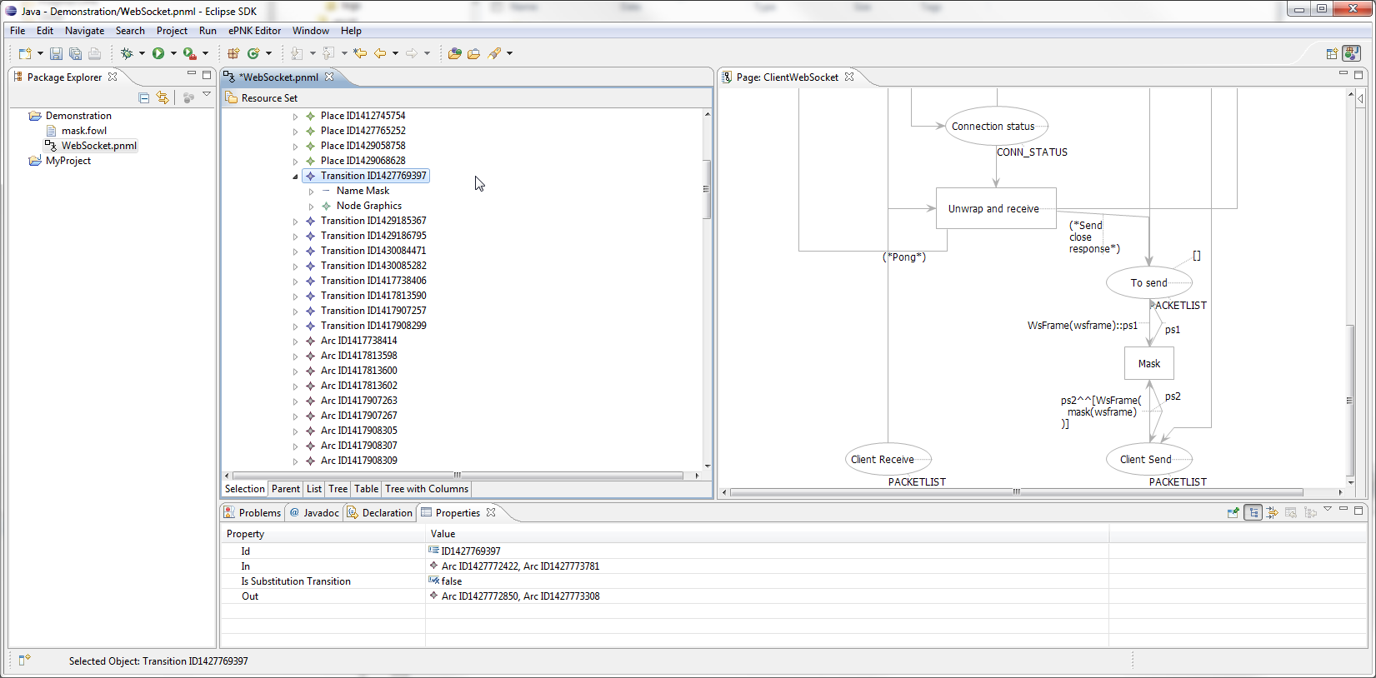
Notes:
And if we try to annotate the transition now

Slide 48
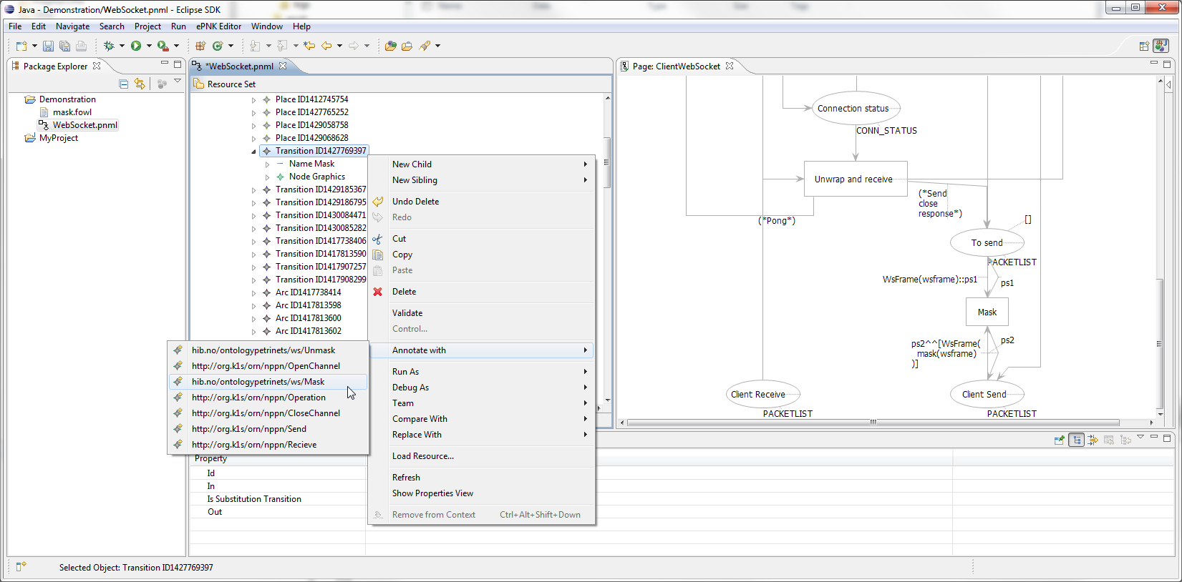
Notes:
zoom
Mask and Unmask is available

Slide 49
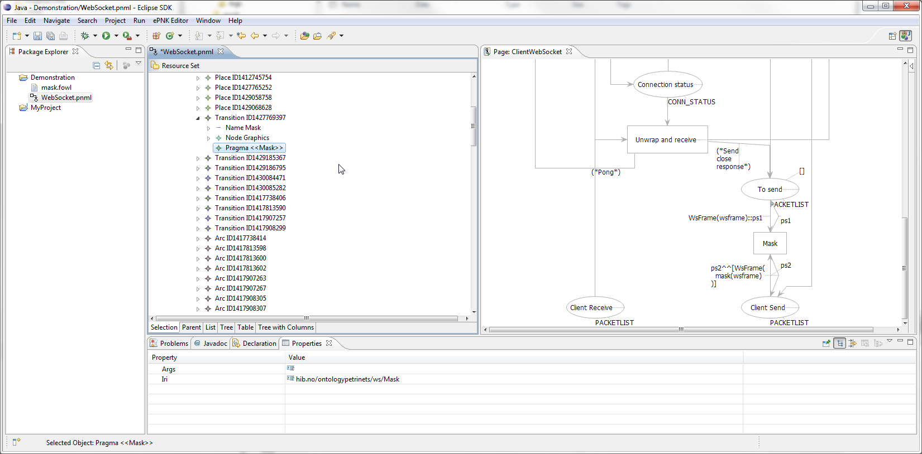
Notes:
Here the pragmatichas been placed.

